Slide 1
The Business Question
How can the Victorian government reduce accidents in Metropolitan Northwestern region?
The Metropolitan North West is one of the fastest growing regions in Victoria, with Wyndham being the fastest growing LGA in the country. Two of the LGAs from the North West region are in the top ten fastest growing LGAs. (Carbines, 2023)
As a result, there are infrastructure, housing and safety and other challenges.
This project concentrates on the road safety issues as I live in this region and my daughter is learning to drive, I wanted to have a better understanding of the same.

Slide 2
Selection of the data
When I dug deeper, I came to know that Northwestern region constitutes about 34% of total accidents.
I decided to concentrate on this region and factors affecting the safety of different road users by further sampling data by infrastructure, accident time and type.
I used the data provided by VicRoads which is vicroad_crashes_last_5_years to answer my business question.
This is an Excel file which includes crash data from July 2014 to June 2019. This is quantitative data.
https://rmitonline.enterprise.slack.com/files/W01AM7K2Q5N/F05CAM7E11S/vicroads_crashes_last_5_years.xlsx

Slide 3
Ethical Consideration Checklist
Checklist | Comments
Identity | The data does not reveal personal identity. Data collected by the Vic government, so I assume care is taken to protect the privacy of the individuals affected. The data will be used for educational purpose only.
Shared Data | The data is publicly available on Victorian Government Data website. The data is being used for the educational purposes and not being shared outside the institute.
Transparency | The data is collected by the VicRoads department of Victorian government, so it is ensured that the data is transparent.
Predictions | The data is being used for educational purposes. Any predictions made would be solely for the same. No actions would be taken based on the predictions.
Bias | Even though the data will be used for educational purposes I would ensure that there is no unconscious or unfair bias in the use of data or analysis of it.
Honesty | The problems will be shared with the audience with complete honesty, no wrong information will be provided intentionally or unintentionally.

Slide 4
Excel Setup Checklist
Checklist | Comments
Meaningful title and location | The worksheet is saved as “Vic Roads crashes 201-2019 dataset” for easy recognition and is saved in my RMIT Course folder.
Format | The column titles are formatted: bold, Fill colour Light Grey and applied to all the titles.
Columns and rows | To us the same naming style objected to object_id,Alcoholtime is changed to Alcohol_time, seriousinjury to serious_injury, otherinjury to other_injury, noninjured to non_injured, heavyvehicle to heavy_vehicle, passengervehicle to passenger_vehicle, publicvehicle to public_vehicle,
Freeze rows/columns | Top rows are frozen, so the column names stay visible.
Check show formula | No formulas found
Create worksheets | No worksheet were created as the working will be done in Tableau.

Slide 5
Clean Data Checklist
Checklist | Comments
1: Create a backup copy | A copy of the file is saved on OneDrive.
2: Check rows and columns | Used Hide and Unhide columns and rows to check empty rows and columns, no empty rows or columns found.
3. Spell check | The data is checked for spelling errors: Review>Spelling
4: Text check -find | Used Home Find and Replace function to find unk. And replace it with unknown to make the data consistent. 2033 replacements made
5: Remove duplicates | All three worksheets are checked for duplicates. None found. Data>Remove Duplicates
6: Text check- Change case | Was not required.
7: Remove spaces and non-printing characters | Data checked for the same and nothing was needed to be done. When the data is brought into Tableau it will read pass these.
8: Merging and splitting columns | Not required
9: All data in same decimal format | All columns like X,Y, vic_grid_x, vic_grid_y are in 3 decimal format. I could not change longitude and latitude decimal format,
10: Single common format for dates yyyy-mm-dd | Here the date format is dd/mm/yyyy which is not changed.
11. Review blank values | There were some blank values columns srns, srns_all, rma, rma_all, divided, divided_all, longitude and latitude which were ignored because some of them were not used in analysis or they were less than 0.5% of the total data.

Slide 6
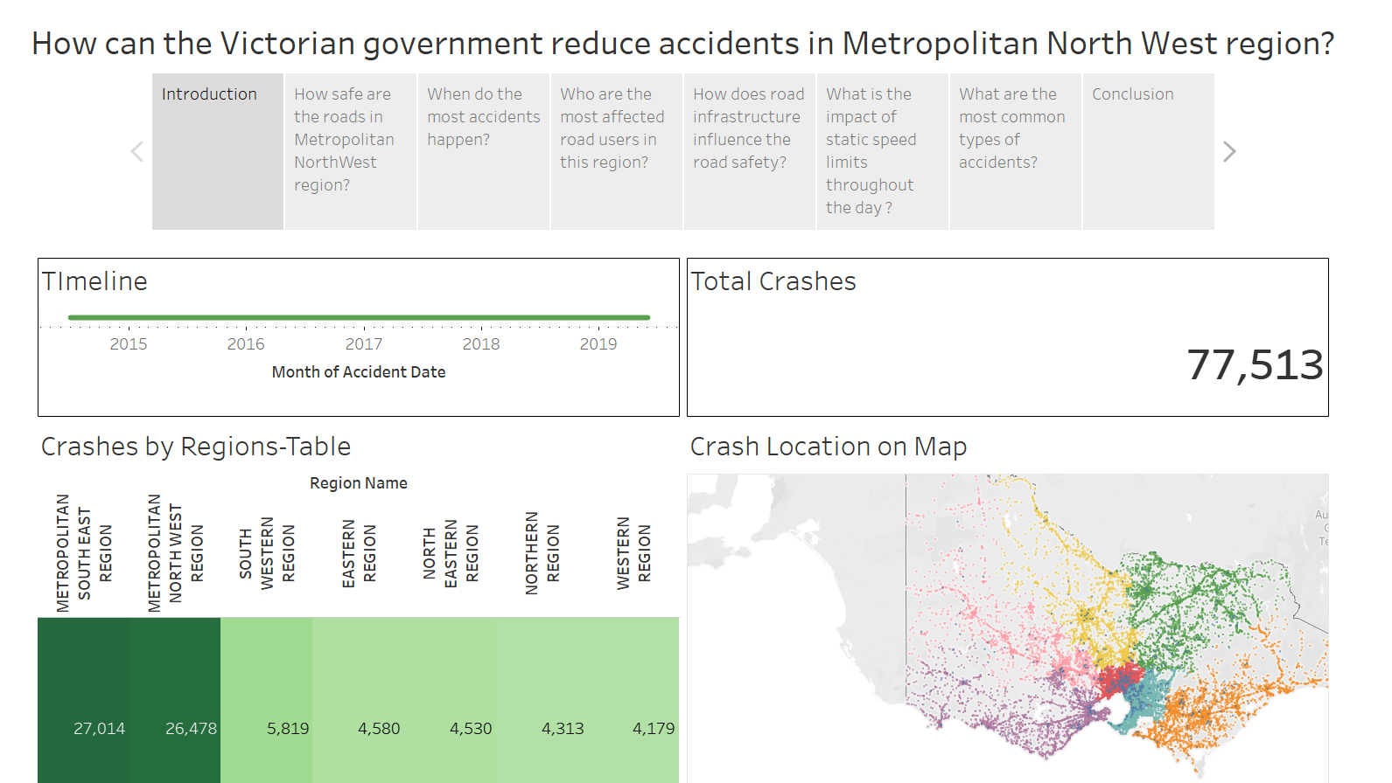

Slide 7
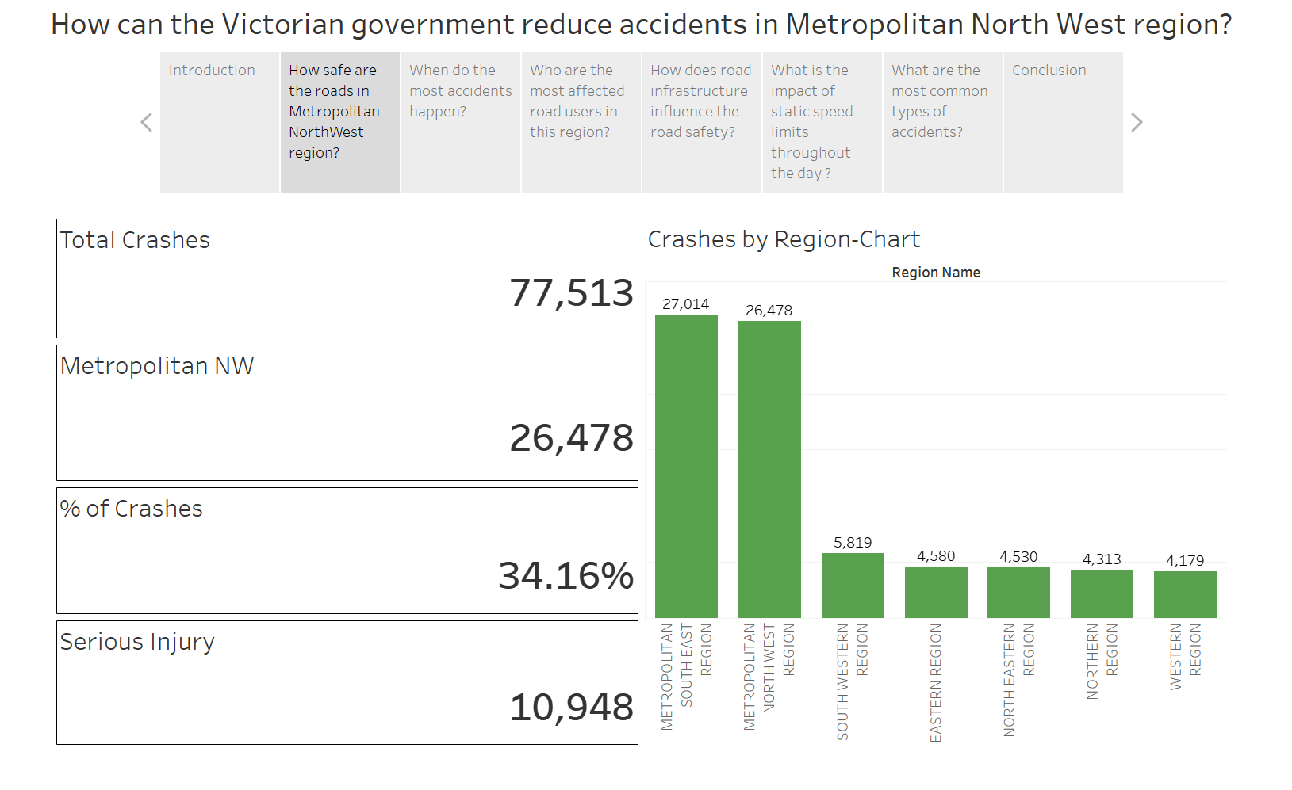

Slide 8
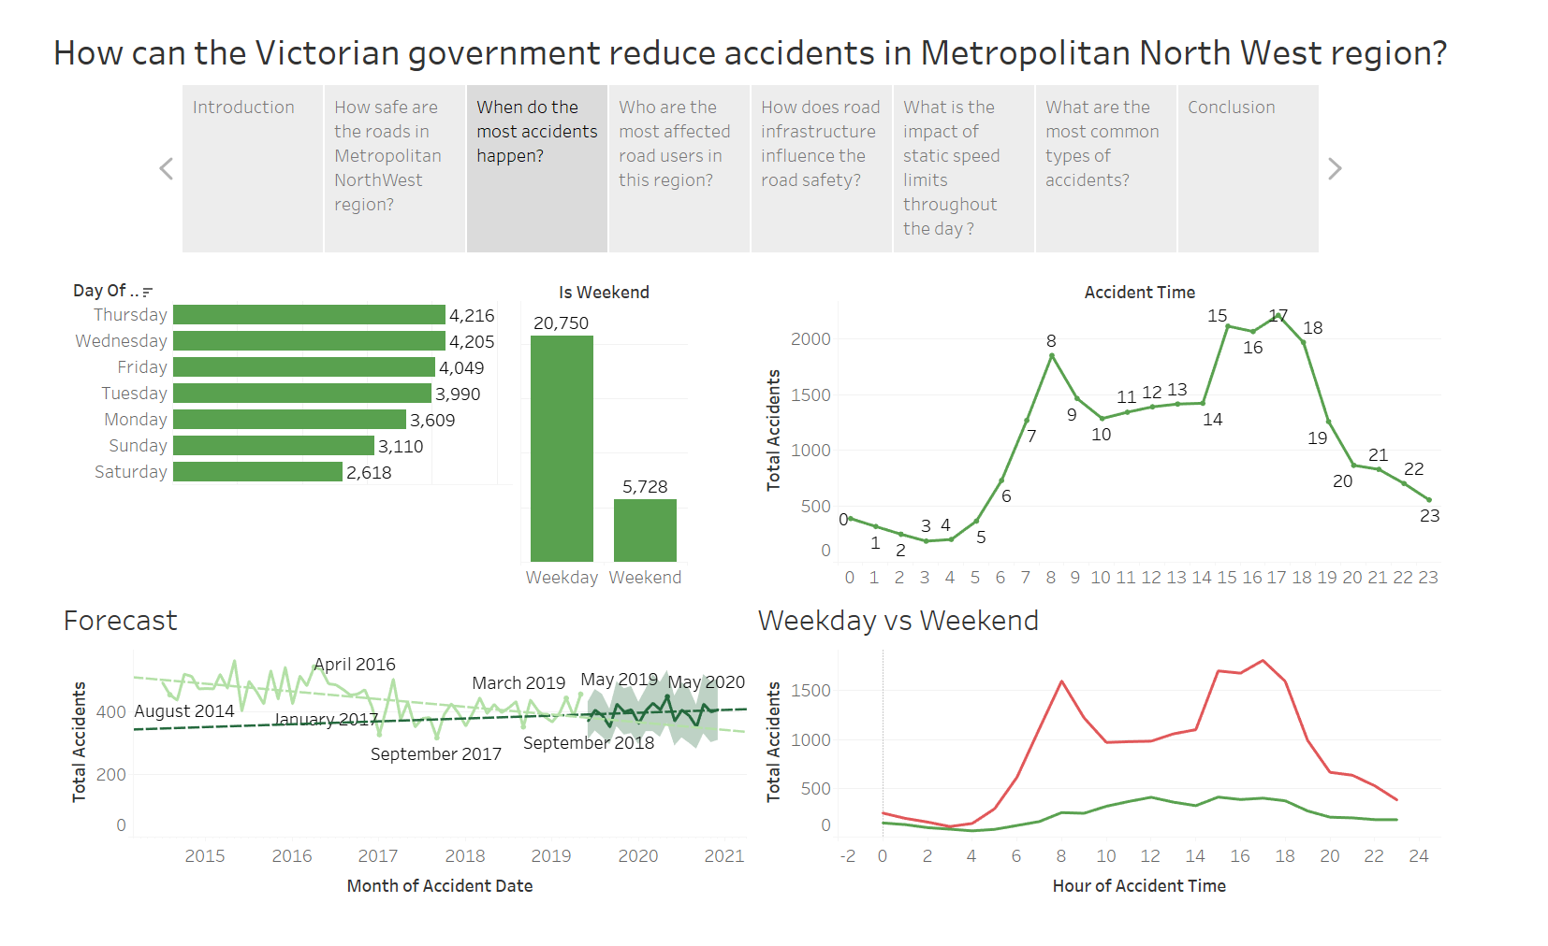

Slide 9
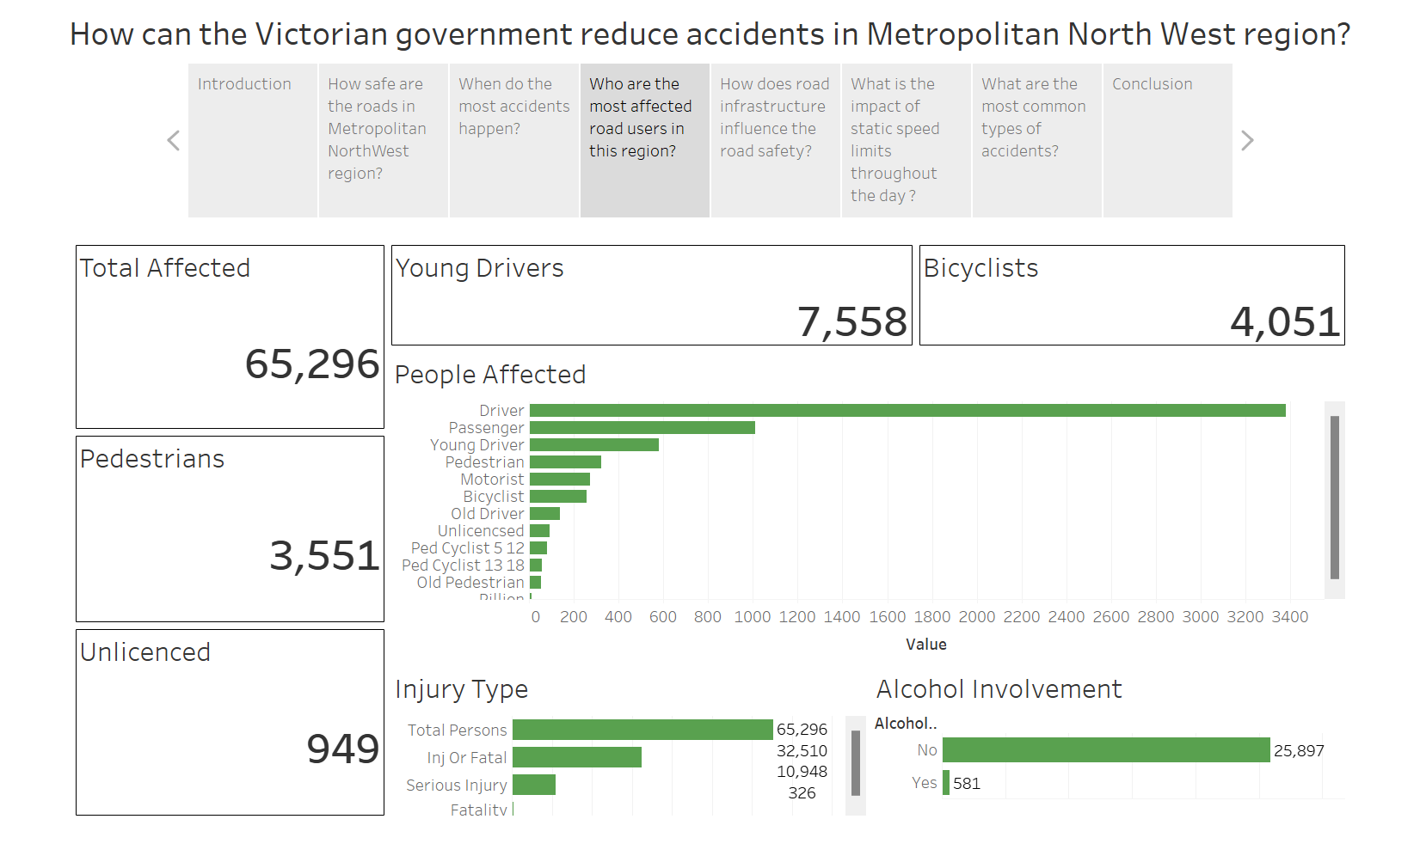

Slide 10
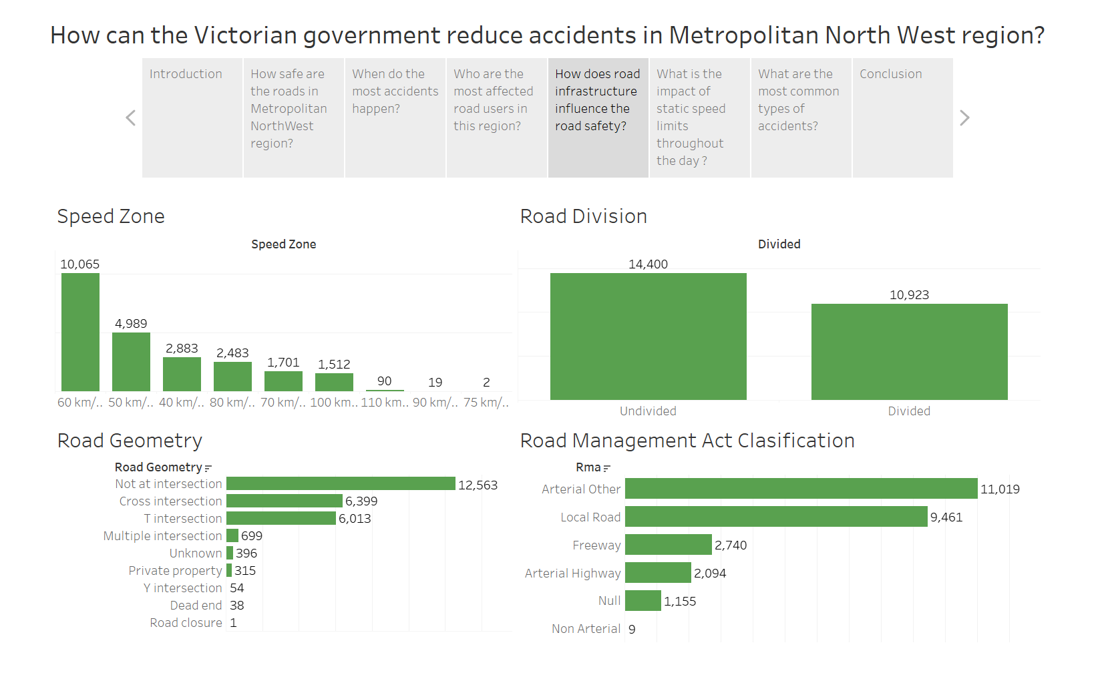

Slide 11
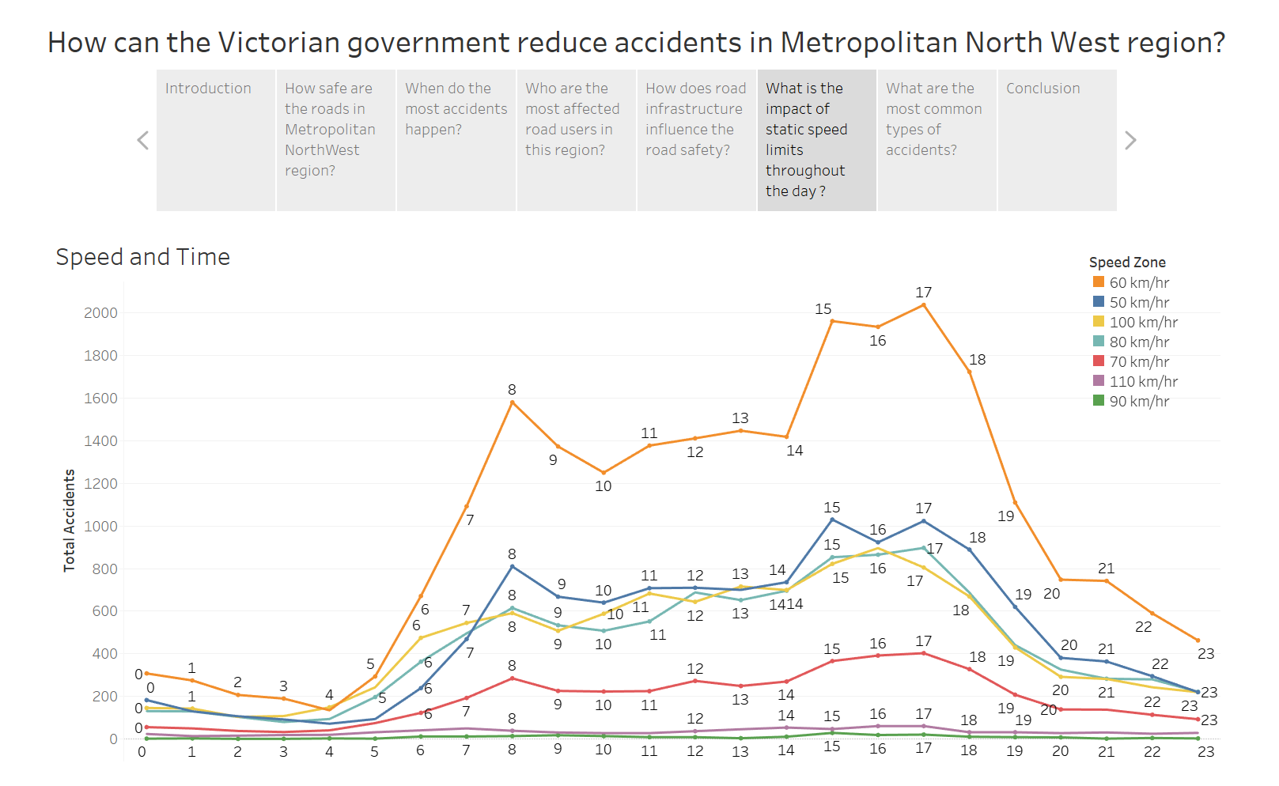

Slide 12
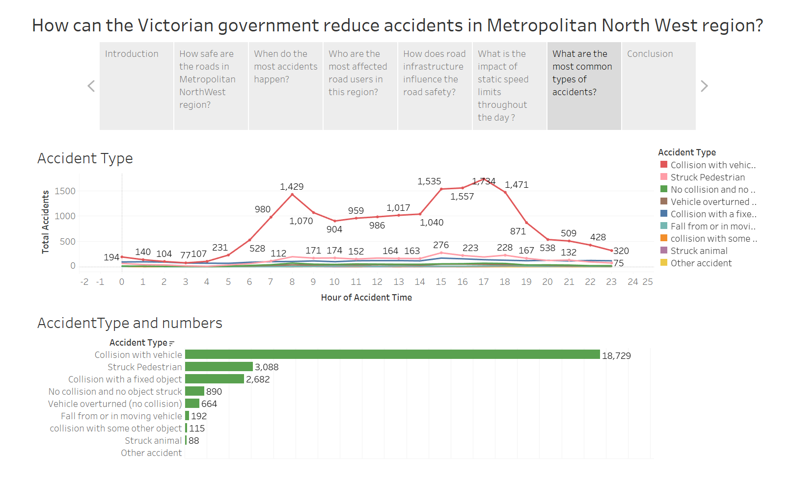

Slide 13
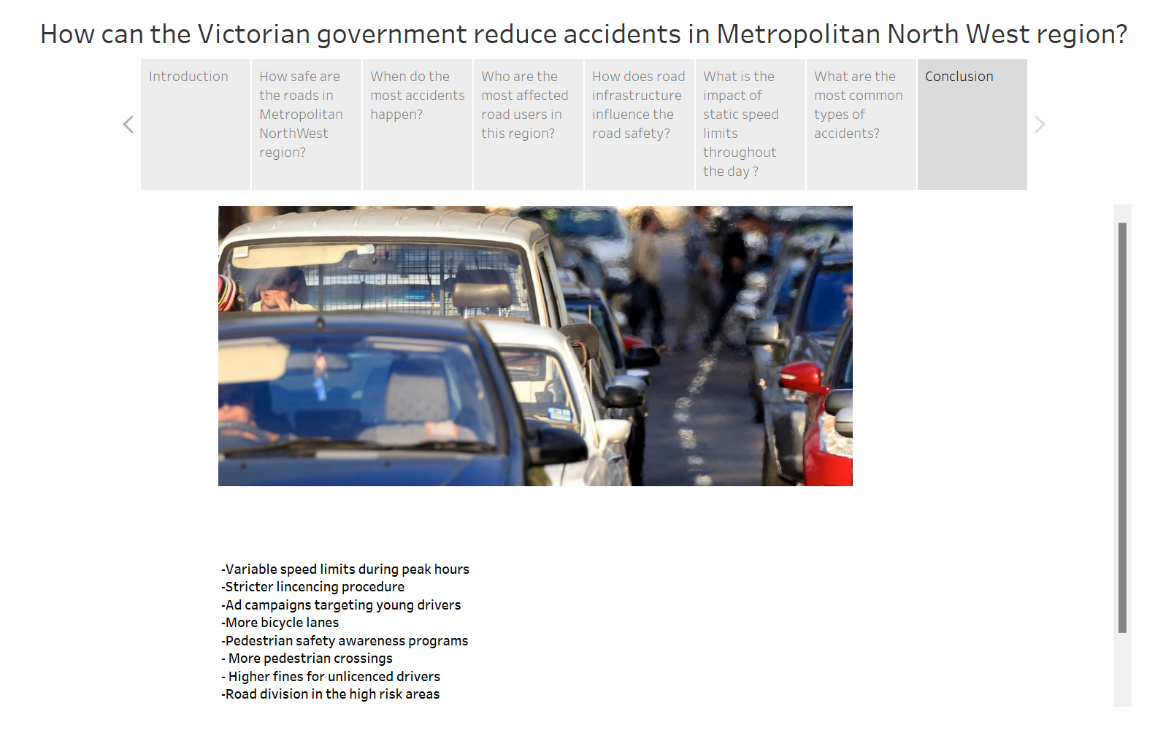

Slide 14
My Findings
The majority of accidents happen in Metropolitan areas as these areas are highly populated, roads are congested, and they have a higher number of road users due to various reasons.
The metropolitan North West is second to the Metropolitan South East just by 536 accidents. It is responsible for 34.15% of total accidents.
Most of the accidents that happen during weekdays are during peak hours- around 8 am and 4 to 6 pm. On the weekend it is spread throughout the day from 8 am to 6 pm with a slight rise on 12 pm and 3 pm.
The forecast suggests that over the period of coming years the number of accidents are going to rise.
During 2014 to 2019 there were a total 65,296 people involved in the accidents. The Metroplitan North west has the highest number of pedestrians and unlicenced drivers involved. The Number of young drivers involved is 7558 which is also very high. The Total number of serious injuries is 10,948.
The majority of accidents happen in 60km/hour speed zones at the peak hours mentioned above. Most accidents in this region happen on arterial other or local roads at the cross and T intersections or not an intersection. At speeds 50 km/h and 40km/hr most accidents happen where the roads are not divided, and pedestrians are struck more where the roads are not divided.

Slide 15
Throughout the day different speed limits have different peaks in accidents however, 8 am and 3-5 pm have highest number of accidents at 60 km/hr, 50 km/hr and 100 km/hr.
Collision with another vehicle tops the types of accidents at 18,729 accidents followed by struck pedestrian at 3,088 accidents.
These insights can help us make the roads safer for all road users.

Slide 16
References
Carbines, S. (2023, January 19). Wyndham: Booming region Australia’s fastest growing in past three years - realestate.com.au. Www.realestate.com.au; Herald SUN. https://www.realestate.com.au/news/wyndham-booming-region-australias-fastest-growing-in-past-three-years/

